Slide 1

COIS 3320H: Fundamentals of Operating Systems
Alaadin Addas
Week 1
Course Introduction

Slide 2
Overview
About Me
Introduce Yourself!
Course Introduction (Policies & Course Structure)
Operating Systems
Defining Operating Systems
Concepts & Terms Relating to Operating Systems
Evolution of Operating Systems

Slide 3
About Me
My name is Alaadin Addas and I will be your instructor for COIS 3320H this semester.
I hold a B.Sc. in Computer Science with a specialization in Software Engineering, and an M.Sc. in Computer Science with a focus on Cyber Security.
I also hold an SSCP certification from ISC^2.
Over the past 5 years I have been working as a software engineer while teaching part-time at several institutions including Trent University, UOIT (Ontario Tech), and Durham College.
In my spare time (the little that I have) I am either spending time with family and friends, taking courses for professional development, or more recently I have been playing games (anything FPS)

Slide 4
Introduce Yourself!
Feel free to unmute and introduce yourself, if you are uncomfortable speaking feel free to type out a quick introduction so that we can all get to know you.
Tell us about yourself
What do you like to be called/how we pronounce your name?
Why you are in this program?
What are your goals?
What year are you in?
What are your hobbies/interests?

Slide 5

Course Introduction

Slide 6
Course Introduction
What is COIS 3320H?
This course is used to introduce you to the fundamental concepts of an Operating System.
You also learn how to program in C within this course.
No, you will not be able to implement an entire OS after completing this course, but you will understand the fundamental concepts such as managing processes, paging, threading, system calls, scheduling, etc…

Slide 7
Tentative Course Schedule (1)
Week | Content
1 | Course Introduction/Introduction to Operating Systems
2 | Processes & Threads
3 | OS Scheduling / Introduction to Programming in C
4 | Concurrency
5 | Deadlock Avoidance, Prevention, and Detection/ More on Programming in C
6 | Memory Management

Slide 8
Tentative Course Schedule (2)
Week | Content
7 | Midterm (March 5th)
8 | Virtual Memory / More on Programming in C
9 | File Systems
10 | Input/Output / More on Programming in C
11 | Protection and Security
12 | Overflow/Content Review

Slide 9
Lecture Format
The lecture is scheduled from 10AM – 12PM on Fridays.
Do you prefer synchronous or asynchronous lectures?
Answer using the poll!

Slide 10
Labs
Throughout this course, we will have 5 labs.
Attending labs is mandatory. However, attending lectures is not mandatory (if we decide on synchronous delivery).
Each lab is worth 5% of your overall mark.

Slide 11
Assignments
Throughout this course, we will have 3 assignments.
The assignments will help improve your understanding of the course material.
Assignments are never released more than 2.5 weeks before the deadline.
Keep in mind that the assignment is designed so that you can finish it in two weeks!
Each assignment is worth 10% of your final mark

Slide 12
Report
An essay (1200 words) about an operating system, highlighting all the difference concepts we discuss in class.
The report is worth 10%.
You must clear your topic with me during the office hours.

Slide 13
Midterm/Final
This course features both a midterm and a final.
The midterm is worth 15% of your overall grade.
The midterm is during our allotted lecture time on the 5th of March.
The final is weighted at 20% of your overall grade.
The final exam will be scheduled during the formal examination period. I have no control of it!
Both the midterm and final are completely open book! ☺

Slide 14
Office Hours
I have a pretty ‘open door’ (open MS Teams) policy.
Our office hours for this course will be hosted on MS Teams on Fridays between 2PM and 3PM.
I don’t typically just up and leave at 3PM if you are still waiting for me to get to you at 3PM I will stick around for as long as I can!
Office hours are first come first serve.
You can message me your question in the general chat, or you can message me privately and we can get on a call.
Be prepared to share your screen!

Slide 15
Contacting Me
Yes you can email me.
My email is aaddas@trentu.ca not alaadinaddas@trentu.ca
Please try to use MS Teams as much as possible though!
MS Teams is the best way to contact me, and I will reply as soon as I can.
If I don’t reply I am not ignoring you, hit me with a ‘?’ in chat ☺.

Slide 16
Late Policy
I have a very strict late policy.
Each business day your assignment/lab is late, the penalty is 10%.
Your assignment cannot be handed in after 5 business days.
I never set deadlines in the middle of the day. If an assignment or lab is due on the 5th of February (for example), it will be due on that date by midnight.

Slide 17

Questions?

Slide 18

Operating Systems

Slide 19
The Operating System
The operating system (OS) is the software that runs on the bare hardware of a computer and provides essential support for users to develop and use applications in the most efficient and safe manner.
The operating system (OS) is the software that runs on the bare hardware of a computer and provides essential support for users to develop and use applications in the most efficient and safe manner.

Slide 20
Mismatch Between Hardware Capabilities and Practical Need
Hardware component | Hardware capabilities | User needs
CPU | Machine instructions perform operations on contents of registers and memory locations. | The user thinks in terms of arrays, lists, and other high-level data structures, accessed and manipulated by corresponding high-level operations.
Main memory | Physical memory is a linear sequence of addressable bytes or words that hold programs and data. | The user must manage a heterogeneous collection of entities of various types and sizes, including source and executable programs, library functions, and dynamically allocated data structures, each accessed by different operations.
Secondary storage | Disk and other secondary storage devices are multi-dimensional structures, which require complex sequences of low-level operations to store and access data organized in discrete blocks. | The user needs to access and manipulate programs and data sets of various sizes as individual named entities without any knowledge of the disk organization.
I/O devices | I/O devices are operated by reading and writing registers of the device controllers. | The user needs simple, uniform interfaces to access different devices without detailed knowledge of the access and communication protocols.

Slide 21
Abstraction and Virtualization
Abstraction: The act of removing unimportant details or attributes of objects in order to construct more general and less complex objects.
Virtualization: The act of creating the illusion of having one or more objects with more desirable characteristics than the real object.
The concepts of abstraction and virtualization are closely related. Abstraction emphasizes simplification and unification of objects, out of which then more complex objects can more easily be constructed. Virtualization may use abstraction, but emphasizes diversification and replication by creating illusions of objects with more favorable characteristics.
An OS is thus an extended machine, which provides efficient high-level functions and virtual entities that liberate the programmer and the user from having to understand details of memory, disk, I/O management, and other internal processes.

Slide 22
Multiprogramming, Time-Sharing, Multi-Tasking
Multiprogramming is a technique that keeps several programs active in memory and switches execution among the different programs to maximize the use of the CPU and other resources.
Time-sharing (multitasking) is an extension of multiprogramming where the CPU is switched periodically among all active computations to guarantee acceptable response times to each user.
Time-sharing ( AKA multitasking) is an extension of multiprogramming where the CPU is switched periodically among all active computations to guarantee acceptable response times to each user.

Slide 23
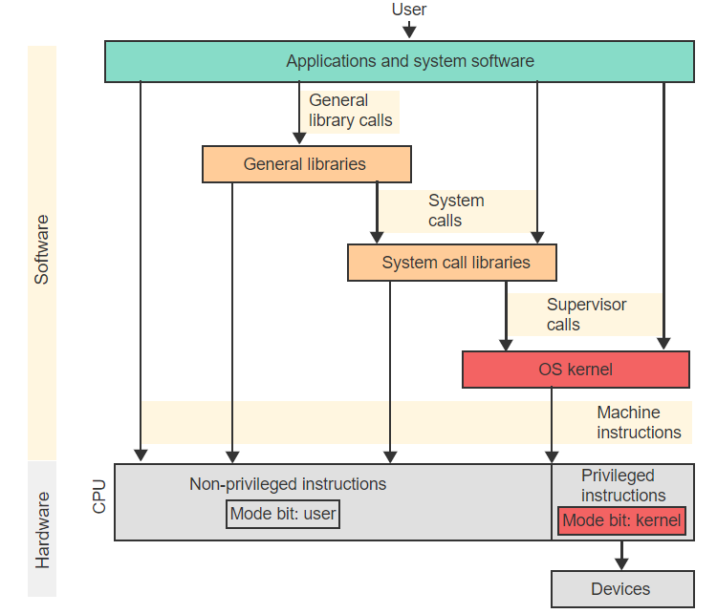
OS Structure

Slide 24
Breaking Down The OS Structure
Kernel: The kernel of an OS is the minimal set of functions necessary to manage the system resources safely and efficiently.
Privileged Instruction: A privileged instruction performs critical operations that access I/O devices and the CPU's status and control registers.
Kernel Mode: Kernel mode is the CPU state where both privileged and non-privileged instructions may be used.
User Mode: User mode is the CPU state where only non-privileged instructions may be used.

Slide 25
Shell or GUI
Most operating systems offer a Graphical User Interface (GUI) for a common user to interact with.
However, and OS Shell can also be used to interact with an operating system.
The OS shell is a command interpreter that accepts and interprets textual commands issued by the user via a keyboard.

Slide 26
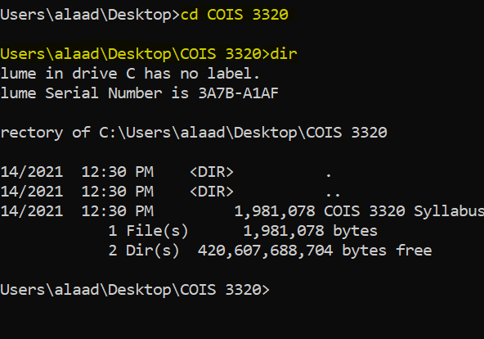
OS Shell
In Windows for example, you can open up a command prompt and input commands such as cd (change directory) to change the current working directory.
In this example, I change the working directory to COIS 3320, a directory in my desktop.
Following that I use the dir command to find the files/directories within the COIS 3320 directory.
Note: on OSx dir = ls, and cd is unchanged.
Why do Operating Systems have GUIs then?

Slide 27
Shell Scripts
You can implement shell scripts to run a series of shell commands.
A shell script is a program that implements a new operation by combining multiple commands and control statement into one named unit interpreted by the shell.
In windows for example, you can use PowerShell to write, save, and execute shell scripts as PS1 files.

Slide 28
Calls
Unrelated to calling your friends, we have several different types of calls when it comes to Operating Systems.
System Call: A system call is a request from an application for an OS service.
Supervisor Call: A supervisor call (kernel call) is a privileged instruction that automatically transfers execution control to a well-defined location within the OS kernel.

Slide 29
Interrupts
An interrupt is an event that diverts the current execution of a program to a predefined location in the kernel in order to respond to an event.
Trap: A trap is an interrupt triggered by the currently executing instruction.
Interrupt Handler: An interrupt handler is a kernel function, invoked whenever an interrupt occurs, that determines the cause of the interrupt and invokes the appropriate kernel function to provide the response.

Slide 30
The Evolution & Scope of OSs
Moore's law, formulated by the scientist Gordon Moore, is the observation that the number of transistors in an integrated circuit doubles about every two years.

Slide 31
Generations of Computers
Gen. | Enabling hardware technology | OS type | Defining characteristics
1 | Vacuum tubes | None | All programming was done by experts in machine language without any support from an OS or any other system software.
2 | Transistors replaced vacuum tubes as smaller and faster switches. | Batch OS | Programs were submitted in batches of punch cards. The role of the OS was to automate the compilation, loading, and execution of programs. Multiprogramming was developed, which allows the OS to schedule the execution of jobs to make more efficient use of the CPU and other resources.
3 | Integrated circuits allowed the development of microchips to replace individual transistors. | Interactive multi-user OS. | Interrupts were developed to allow the OS to enforce time-sharing and to interact with keyboards and display terminals, also developed during the same period. Increased capacity and speed of memory and secondary storage devices imposed additional management tasks on the OS.
4 | Very large scale integration (VLSI) allowed the placement of a complete microprocessor on a single chip, leading to the development of personal computers (PCs). | Desktop and laptop OS. | The OS was responsible for all operations, starting from the initial booting, to multitasking, scheduling, interactions with various peripheral devices, and keeping all information safe. The emphasis was on user-friendliness, including the introduction of the GUI.
5 | Networking hardware enabled the harnessing of the power of multiple computers. | OSs for supercomputers, distributed systems, and mobile devices. | The ability to create extremely powerful chips spawned several directions of development. Supercomputers combined large numbers of processors and made the OS and other software responsible for exploiting the increased computation power through parallel processing. Computer networks gave rise to the Internet, which imposed requirements of privacy and safety along with efficient communication. Wireless networks led to the development of hand-held devices, with additional demands on the OS.

Slide 32
OS Types & Applications
Type of operating environment | Common application areas | Major emphases
Mainframe: a large central computer used by large organizations. | High-volume data processing in administration, banking, government. | High throughput, management of large storage.
Server: a large computer that responds to requests from individual clients. | Web and email processing, Internet commerce. | Fast response, security.
Multiprocessor: a system of multiple CPUs and memories interconnected by a fast network into a single parallel computer. | Scientific and other high-performance computations. | Fast interprocess communication and memory access. Data consistency.
Distributed system (multi-computer): a network of independent computers interconnected via a communication network. | Sharing of data and services, internet commerce. | Efficient and secure communication. Support for many types of applications and services.
Desktop or laptop: a personal computer. | Word processing, personal finance, access to Internet, games. | User-friendly interface. Intuitive organization of data and applications. Support for a variety of tasks without much technical knowledge of the inner functioning of the computer.
Hand-held device: small, portable, wireless-capable device for personal use. | Smartphones, tablets. | User-friendly interface. Easy integration of new applications. Support for microphone, speaker, camera, GPS, motion sensor, and other components.
Real-time system: a computer, frequently embedded in a larger electro-mechanical system, that must respond rapidly to external events. | Control of industrial processes, vehicle and aircraft control, audio and video transmission. | Scheduling to meet all deadlines. Reliability in life-critical applications.
Sensor network: collection of small, spatially distributed dedicated sensors communicating by wired or wireless connections. | Industrial, environmental, or military monitors. Wearable devices. | Minimize power consumption. Form ad-hoc connections and tolerate node failures.

